Slide 1
SMART Home
Group 2:
John Satterla – Computer Engineer – Wireless Connectivity
Zachary Eakerns (Team Lead) – Electrical Engineer – Biomedical Station
Zarka McClung – Computer Engineer – Facial Recognition
Christian Jensen – Electrical Engineer – Voice Recognition

Slide 2

Last Week's Deliverables
John Satterla
Zachary Eakerns
Zarka McClung
Christian Jensen
Find software to more accurately simulate filters
Improve filter performance and prepare to construct actual circuits
Research Algorithm and try to implement it
Choose suitable programming language and install IoT on RasPi
Try to use webcam to test Algorithm with detection code
Design and order parts for relay circuit
Research Raspberry Pi Smart home front ends
Order and test Zigbee modules
Finalize and start developing with MCU development kits

Slide 3
Changes From Original Plan
Medical devices, specifically a pulse oximeter, can be high inaccurate due to even small amounts of movement
To get more meaningful, useful data the device will no longer be connected to the person
Instead, a station will be placed in the home that the patient can sit down with and check vitals
This approach emphasizes accuracy over mobility

Slide 4
Troubles With Filters
Although the values needed to make the amplifiers and filters are simple to calculate, real life results vary heavily from theoretical ones
For the EKG machine the lowpass filter is cutting down on the voltage much quicker than anticipated
While this could still work, fine tuning needs to be done to be able to create a more accurate machine

Slide 5
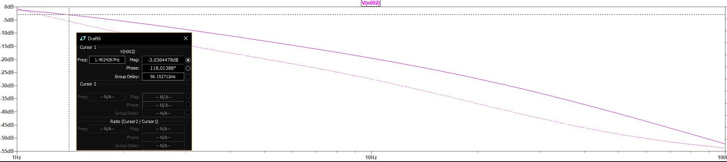
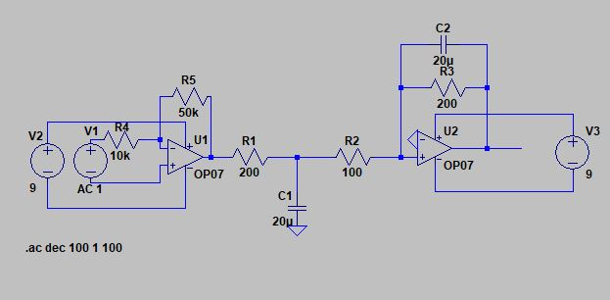

Slide 6
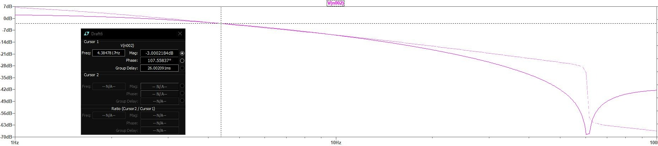
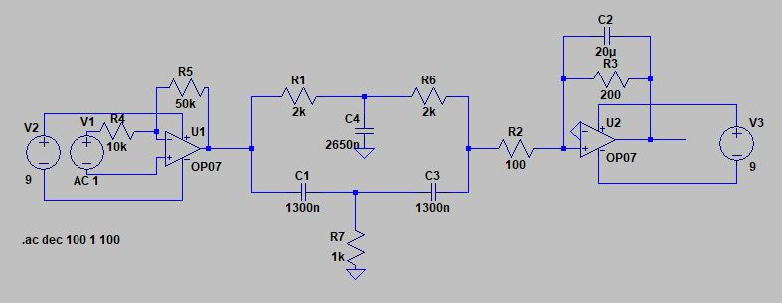

Slide 7
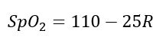
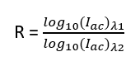
Pulse Oximetry Calculations
Blood oxygenation can be calculated by finding the peak voltages given from the phototransistor for both the Red and IR LEDs
Found using the equation
Where

Slide 8
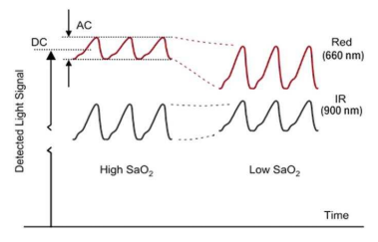
[6]

Slide 9
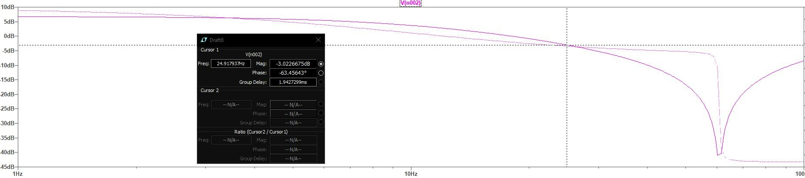
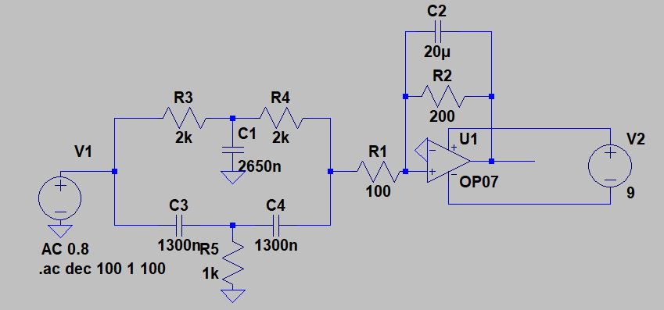

Slide 10
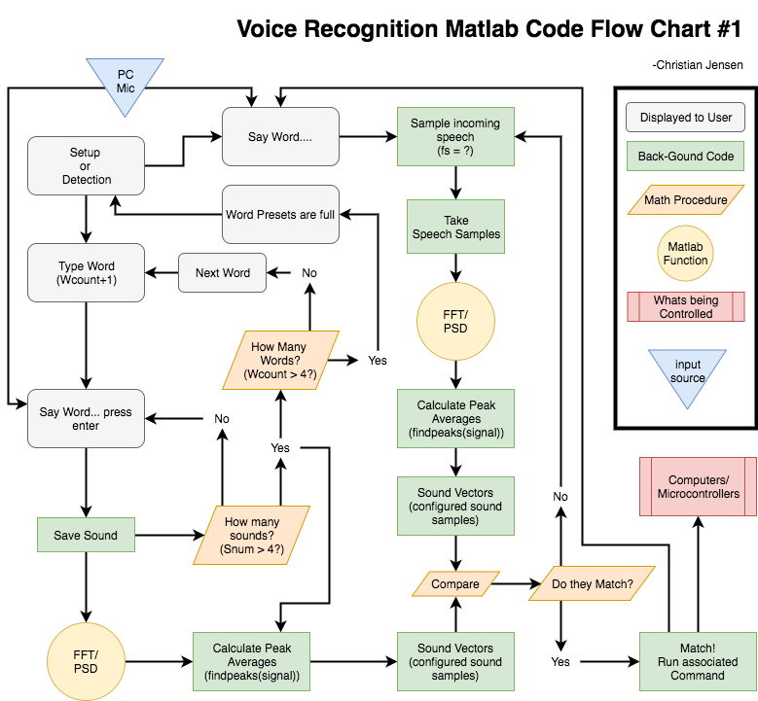

Slide 11
Voice Recognition Methods
Process:
Ask user to set up phrases before
Type name of phrase
Speak the phrase (3x times)
Take the FFT of the signal
Analyze the highs of the psd
Save average highs for each word
Speech recognition
Poll for incoming phrases
Sample input (fs = ?)
Take the FFT of the signal
Analyze the highs of the psd
Compare with saved averages
Matlab [6]
Would use the computer and its microphone to detect voice
Allows for easier integration with the entire project
Using built-in Matlab functions
fft() : Fast Fourier transform [4]
findpeaks(data) : Finds extremes with location vector [5]
*The system will be speaker dependent
(Only recognizing one specific person's commands)

Slide 12
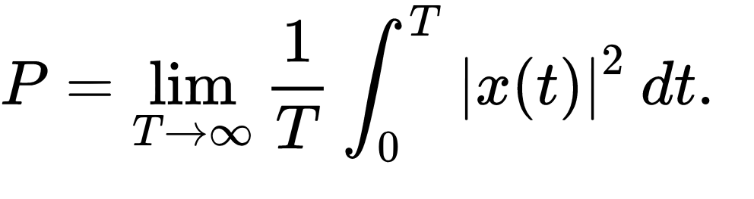
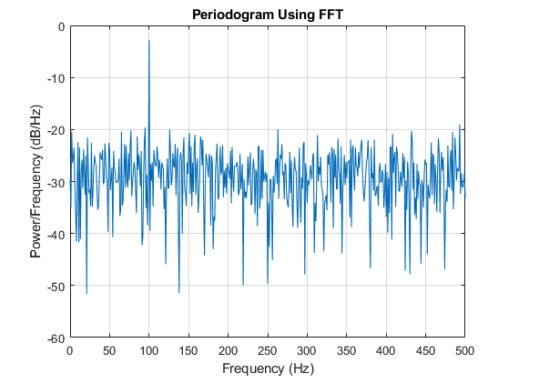
Voice Recognition Mathematics
Power spectral density equation [9]
Matlab psd graphical example [7]

Slide 13
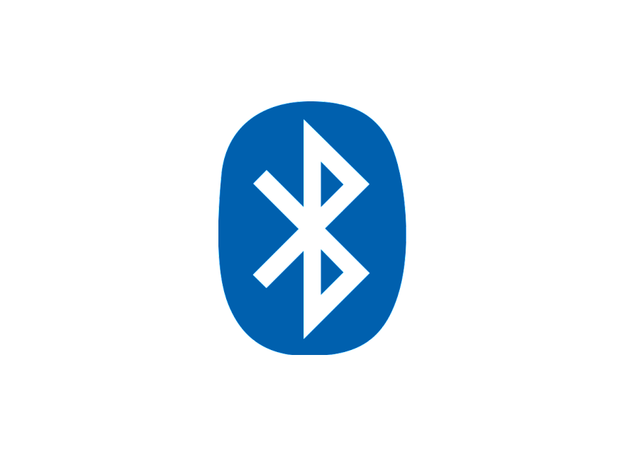







System Overview
Bluetooth ToF Beacon
Zigbee Communication
Facial Recognition/ Voice Command for door and 2 TBD appliance
Television
Wireless Patient Monitor
Central processing station receives and displays data from user and devices
via TBD wireless technology
Determines position in Room from BLE Beacons
Sends user data to central processing station for monitoring and web via TBD wireless protocol
Door
Lights throughout
Fan
Room/Space Dimensions TBD
John Satterla

Slide 14
Controlling Devices Wirelessly with Zigbee
Zigbee is a Wireless, low power mesh networking protocol designed for home and building automation
It supports low data rates (250kbps) and works on top of the defined IEEE 802.15.4 physical layer [16]
The protocol was standardized in 2003 and is maintained by the Zigbee Alliance
Zigbee is probably in most of your homes today, with smart hubs like the Amazon Alexa or Google’s Nest able to connect all devices together
John Satterla

Slide 15
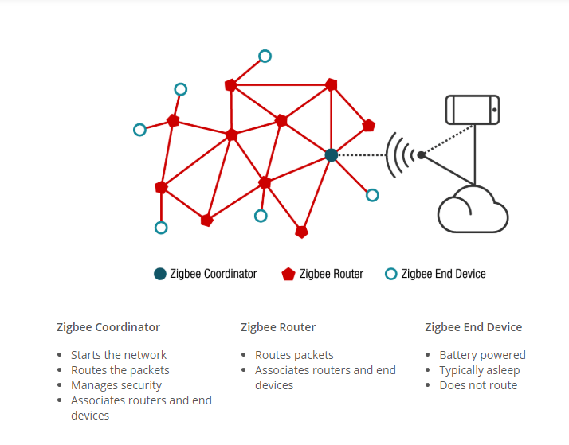
Controlling Devices Wirelessly with Zigbee
Zigbee Network Topology [16]
John Satterla

Slide 16
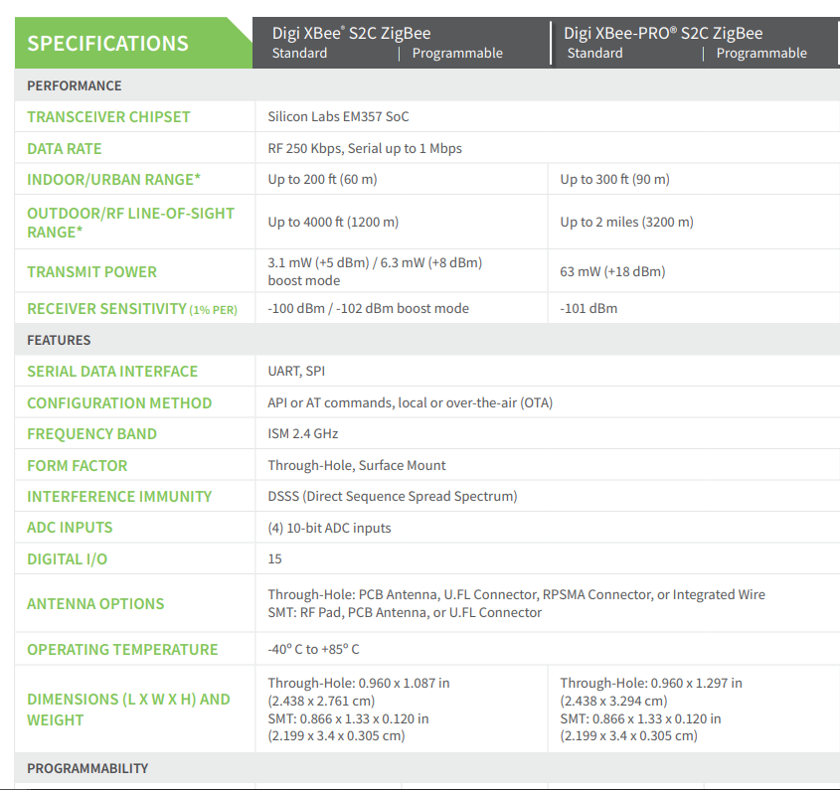
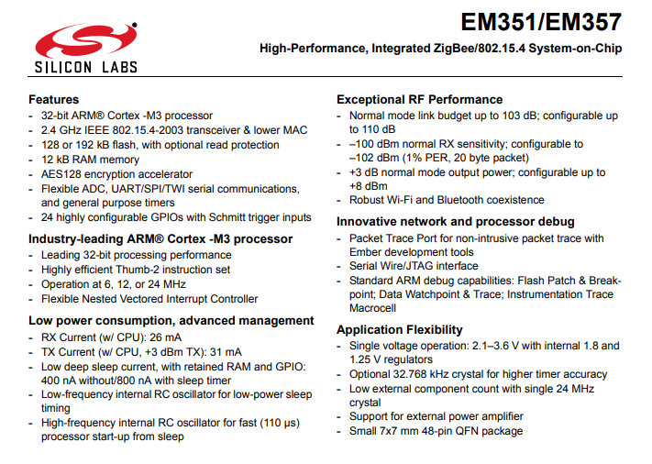
Controlling Devices Wirelessly with Zigbee
For our purposes, we will use Wireless microcontrollers that are integrated into Digi’s “Xbee” modules
[3]
[6]
John Satterla

Slide 17
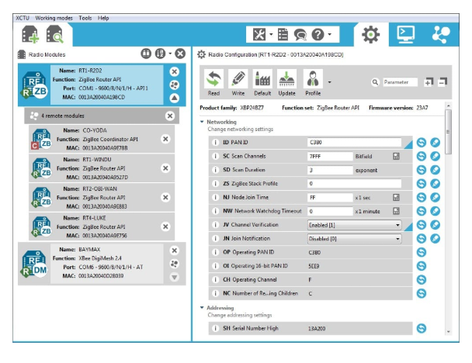
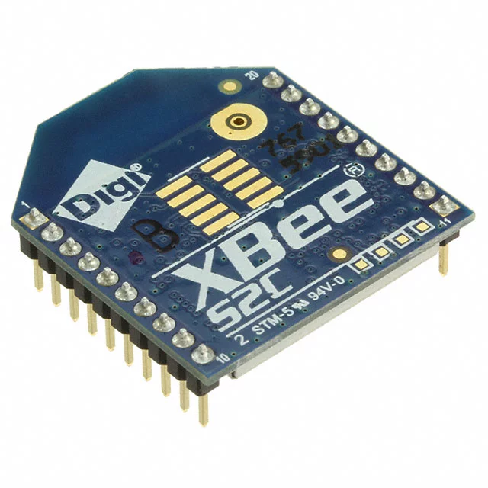
Controlling Devices Wirelessly with Zigbee
Using these so that we do not have to do any RF layout with wireless MCUs/ time constraints
Can communicate and be programmed separately for wireless purposes to form network with IDE, and then communicate back to main MCU via SPI or UART
[3]
John Satterla

Slide 18
Tracking Location of the Patient Monitor
Ideally work indoors, so using GPS not preferred because of accuracy and not able to get fix inside of buildings
BLE ToF – Bluetooth Time of Flight
Time of Flight is used to estimate range by measuring the round trip delay of an RF packet exchange
At least two devices needed, and operate generally as a master and a slave, where the master calculates average round trip delay for hundreds of packets to be as accurate as possible (try to reduce error from interference, other RF related differences) [ref]
John Satterla

Slide 19
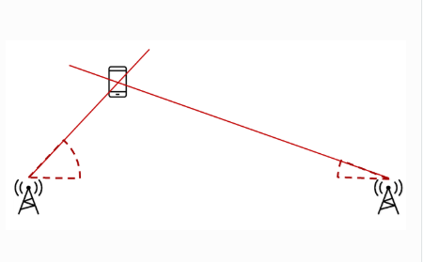
Tracking Location of the Patient Monitor
For this, Texas Instruments has a experiential stack that I am going to evaluate and see what kind of performance I can get
The tricky part will be using two masters that are positioned at two known points, and then connecting to the single slave on the patient to triangulate it’s position
Patient monitor
Master 2
Master 1
[1]
John Satterla

Slide 20
Tracking Location of the Patient Monitor
Hardware on order:
TI CC2640R2F Launchpads
Why an SoC? Ability to quickly sample the data coming from the slave and calculate the distance via ToF
Specs:
CPU: ARM Core M3 @ 48 MHz
Memory: 128kB flash, 28kB RAM
Radio: 2.4GHz with Certified Bluetooth 5, 4.2 support, 102 dB link budget for BLE
Peripherals: I2C, ISS, UART, TRNG, AES-128
Low power features: RX at 0dBm – 5.9 mA, TX at +5dBm – 9.1 mA, as low as 1.1uA standby
General: 3.3V operation
John Satterla

Slide 21
Blinking LED test using VS and RasPi
Created a simple LED blinking code and connected a LED to Windows 10 IoT Core device. (Raspberry Pi 2 Model B)
Goal was to verify communication between Raspberry Pi and the computer

Slide 22
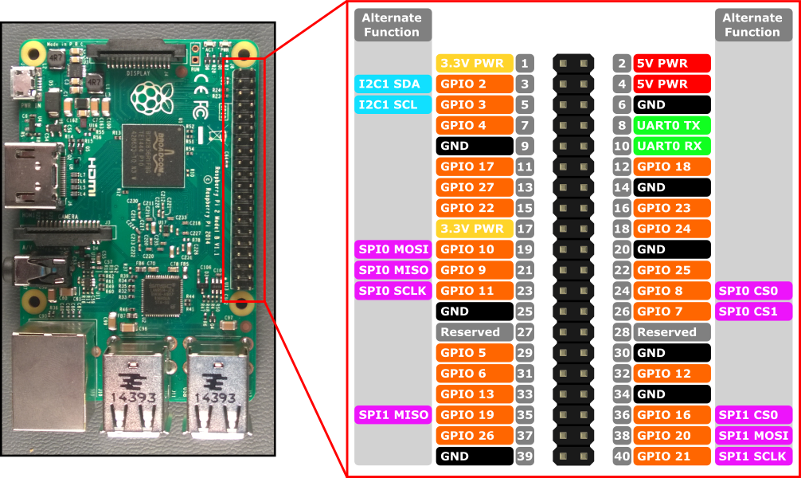
Windows 10 IoT with Visual Studio
Connected LED to GPIO 5 (Pin 29) and 3.3V PWR (Pin 1)
Powered it using an adapter
5V (2000mA max)
Connected Ethernet port to transfer data from PC to RasPI
GPIO total output current limit is 100mA

Slide 23
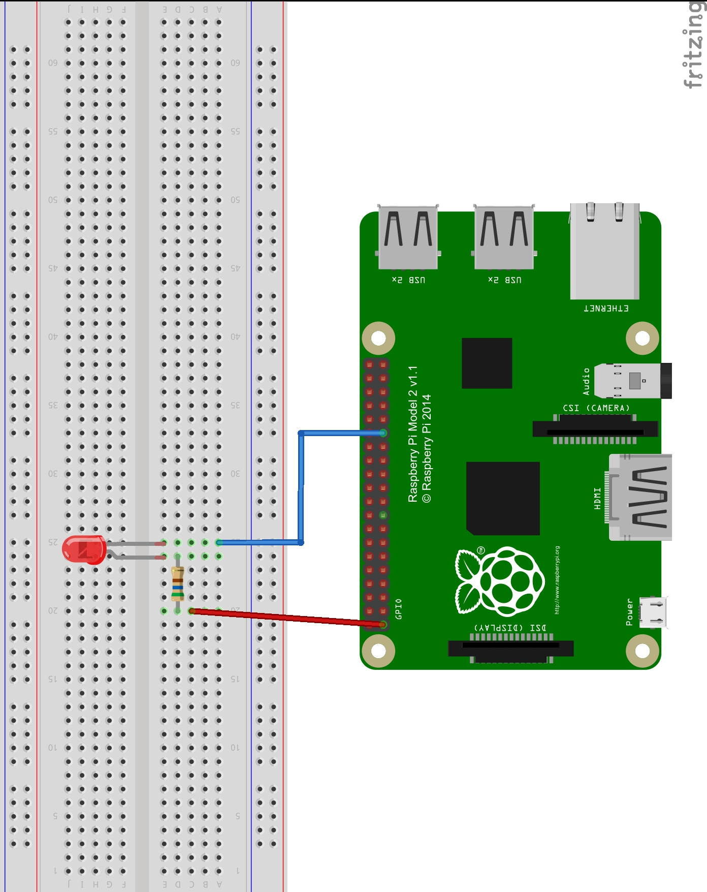
Assembled circuit
3.3V Supply
300 ohm resistor
Blinks every 500ms

Slide 24
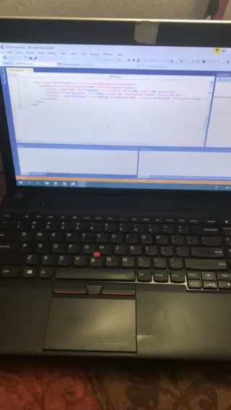
Demo Video

Slide 25
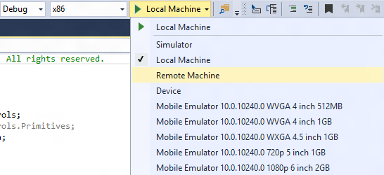
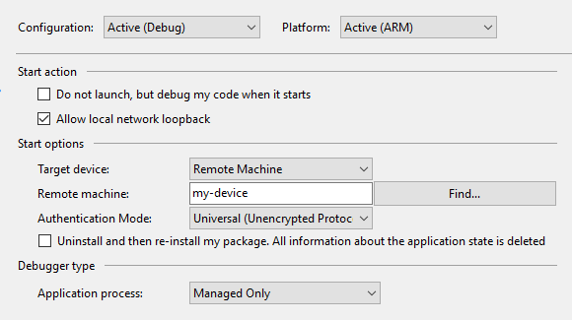
Visual studio remote connection setup
Remote machine’s name and IP address was collected using IoT Dashboard

Slide 26
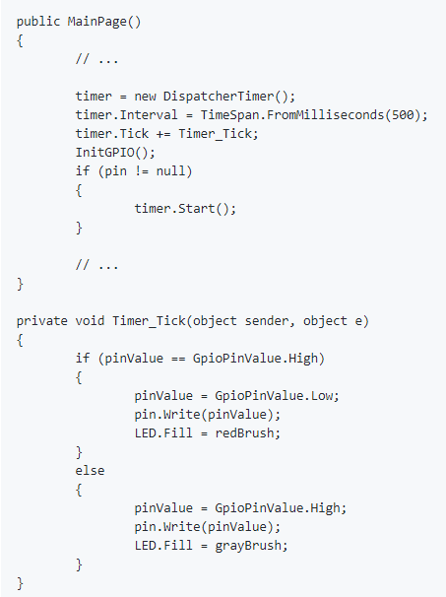
Code explained
The code for this sample is simple.
We use a timer, and each time the ‘Tick’ event is called, we flip the state of the LED.

Slide 27
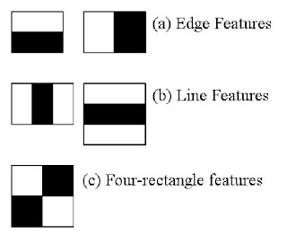
Concept behind the Algorithm
Initially, the algorithm needs a lot of positive images (images of faces) and negative images (images without faces) to train the classifier. Then we need to extract features from it.
Each feature is a single value obtained by subtracting sum of pixels under the white rectangle from sum of pixels under the black rectangle.

Slide 28
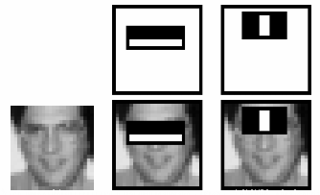
Calculation Method
For each feature calculation, we need to find the sum of the pixels under white and black rectangles.
To solve this, they introduced the integral image. However large your image, it reduces the calculations for a given pixel to an operation involving just four pixels.
It makes things super-fast.
But among all these features we calculated, most of them are irrelevant.
For example, consider the image above. The top row shows two good features. The first feature selected seems to focus on the property that the region of the eyes is often darker than the region of the nose and cheeks.
The second feature selected relies on the property that the eyes are darker than the bridge of the nose. But the same windows applied to cheeks or any other place is irrelevant. So how do we select the best features out of 160000+ features?

Slide 29
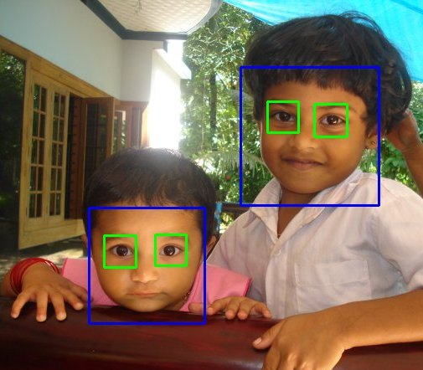
How do we select the best features out of 160000+ features?
For this, we apply each and every feature on all the training images. For each feature, it finds the best threshold which will classify the faces to positive and negative. Obviously, there will be errors or misclassifications. We select the features with minimum error rate, which means they are the features that most accurately classify the face and non-face images.

Slide 30
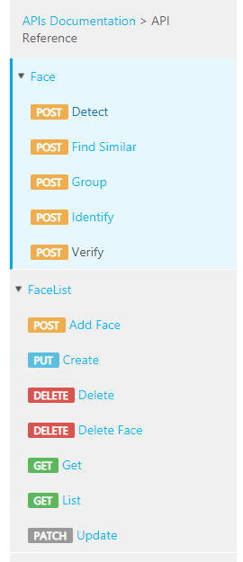
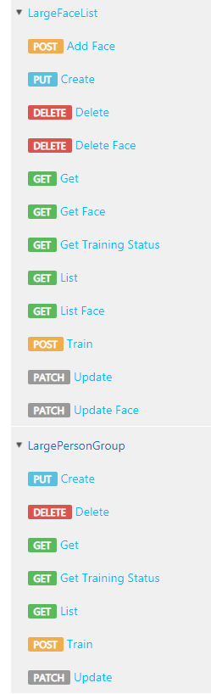
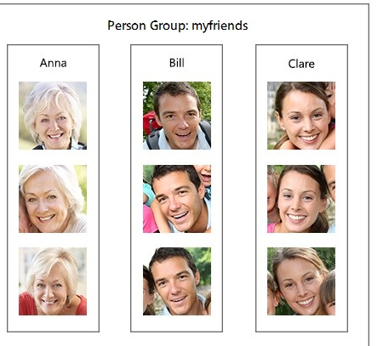
Was able to get Microsoft Cognitive Services key for free
The following figure is an example of a LargePersonGroup/PersonGroup named "myfriends“.
Each group may contain up to 1,000,000/10,000 person objects. Meanwhile, each person object can have up to 248 faces registered

Slide 31
Microsoft Face API Research Phase
Microsoft’s Face API’s algorithm is not shared.
I am using OpenCV to understand how face is recognized (the concept behind it).
Most facial recognition APIs use a similar concept
Microsoft’s API has many of resources
Still debating OpenCV Vs Microsoft Face API

Slide 32
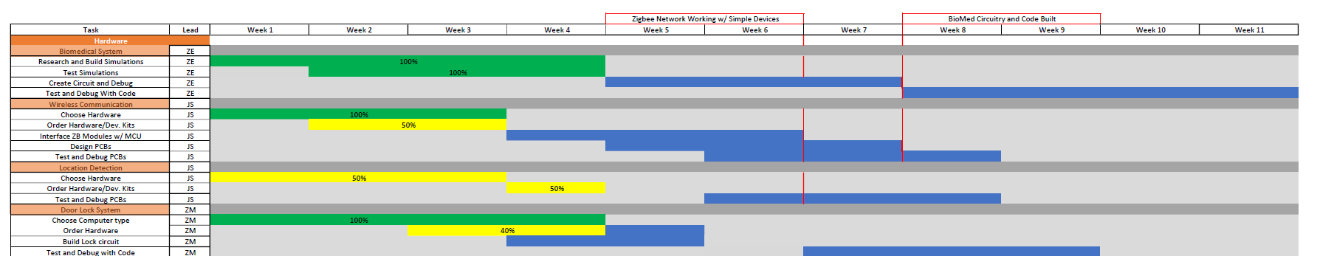
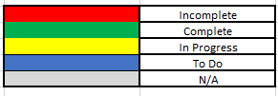
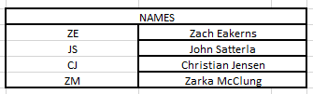
Gantt Chart

Slide 33
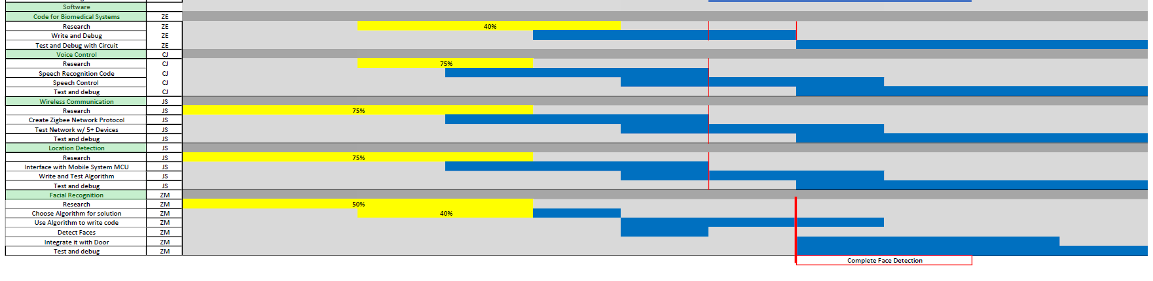
Gantt Chart

Slide 34
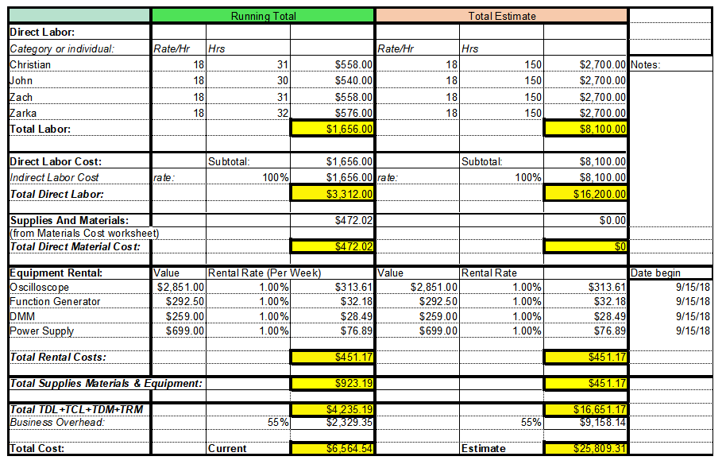
Budget

Slide 35
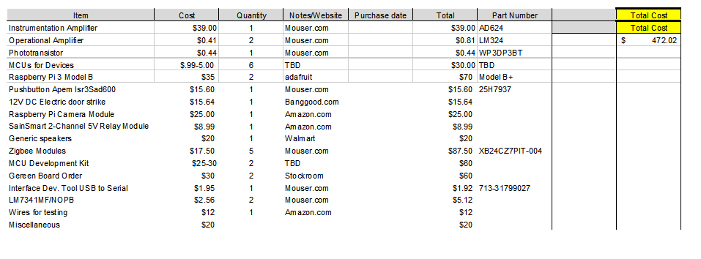
Material Cost

Slide 36
Next Week's Deliverables
John Satterla
Zachary Eakerns
Zarka McClung
Christian Jensen
Get Zigbee modules and establish communication
Test BLE ToF with launchpads (arriving today)
Built and begin testing filters
Begin writing and testing software for peak detection
Keep working on implementing Face recognition code
Research on Face API
Get webcam to test code
Start sampling input words to find what fs to use
Continue writing Matlab code
Research Matlab controlling MCUs through computer

Slide 37
References
Cdn-learn.adafruit.com. (2018). [online] Available at: https://cdn-learn.adafruit.com/downloads/pdf/introducing-the-raspberry-pi-2-model-b.pdf [Accessed 3 Oct. 2018].
Dev.ti.com. (2018). Localization Toolbox — SimpleLink™ CC2640R2 BLE-Stack User's Guide for *Bluetooth®* 4.2 3.02.00.00 documentation. [online] Available at: http://dev.ti.com/tirex/content/simplelink_cc2640r2_sdk_2_20_00_49/docs/blestack/ble_user_guide/html/localization/index.html [Accessed 3 Oct. 2018].
“DIGI XBEE® AND DIGI XBEE-PRO® ZIGBEE,” digi.com, 2018. [Online]. Available: https://www.digi.com/pdf/ds_xbee_zigbee.pdf. [Accessed: 25-Sep-2018].
Docs.opencv.org. (2018). OpenCV: Face Detection using Haar Cascades. [online] Available at: https://docs.opencv.org/3.4/d7/d8b/tutorial_py_face_detection.html [Accessed 26 Sep. 2018].
Docs.microsoft.com. (2018). Setting up your device - Windows IoT. [online] Available at: https://docs.microsoft.com/en-us/windows/iot-core/tutorials/quickstarter/devicesetup#using-the-iot-dashboard-raspberry-pi-and-minnowboard [Accessed 3 Oct. 2018].
“EM351/EM357 High-Performance, Integrated ZigBee/802.15.4 System-on-Chip,” silabs.com, 2013. [Online]. Available: https://www.silabs.com/documents/public/data-sheets/EM35x.pdf. [Accessed: 25-Sep-2018].
“fft,” Reconstructing an Image from Projection Data - MATLAB & Simulink Example. [Online]. Available: https://www.mathworks.com/help/matlab/ref/fft.html. [Accessed: 03-Oct-2018].
“findpeaks,” Reconstructing an Image from Projection Data - MATLAB & Simulink Example. [Online]. Available: https://www.mathworks.com/help/signal/ref/findpeaks.html. [Accessed: 03-Oct-2018].
GitHub. (2018). Microsoft/Windows-iotcore-samples. [online] Available at: https://github.com/Microsoft/Windows-iotcore-samples/blob/develop/Samples/HelloBlinky/CS/README.md [Accessed 3 Oct. 2018].
How to Design Peripheral Oxygen Saturation (SpO2) and Optical Heart Rate Monitoring (OHRM) Systems Using the AFE4403, 3AD. [Online]. Available: http://www.ti.com/lit/an/slaa655/slaa655.pdf. [Accessed: 20-Sep-2018].
Mathworks.com. (2018). Power Spectral Density Estimates Using FFT- MATLAB & Simulink. [online] Available at: https://www.mathworks.com/help/signal/ug/power-spectral-density-estimates-using-fft.html [Accessed 3 Oct. 2018].
Ning, D. (2018). Developing an Isolated Word Recognition System in MATLAB. [online] Mathworks.com. Available at: https://www.mathworks.com/company/newsletters/articles/developing-an-isolated-word-recognition-system-in-matlab.html [Accessed 24 Sep. 2018].
“Spectral density,” Wikipedia, 24-Jul-2018. [Online]. Available: https://en.wikipedia.org/wiki/Spectral_density. [Accessed: 03-Oct-2018].
Ti.com. (2018). SIMPLELINK-SDK-VOICE-DETECTION-PLUGIN Voice Detection plug-in for the SimpleLink™ MCU Software Development Kit (SDK) | TI.com. [online] Available at: http://www.ti.com/tool/SIMPLELINK-SDK-VOICE-DETECTION-PLUGIN [Accessed 25 Sep. 2018].
Westus.dev.cognitive.microsoft.com. (2018). Microsoft Cognitive Services. [online] Available at: https://westus.dev.cognitive.microsoft.com/docs/services/563879b61984550e40cbbe8d/operations/563879b61984550f3039523a [Accessed 3 Oct. 2018].
“Zigbee | Overview | Wireless Connectivity,” SimpleLinkTM Zigbee Wireless MCUs, 2018. [Online]. Available: http://www.ti.com/wireless-connectivity/simplelink-solutions/zigbee/overview.html. [Accessed: 26-Sep-2018].

Slide 38
Questions?

